Slide 1
Credit Card Fraud Detection Capstone Project
Submitted by:
Bhupendra Gautam

Slide 2
Agenda
 Objective
 Background
 Key Insights
 Cost Benefit Analysis
 Appendix:
Data Attributes
Data Methodology
Attached Files

Slide 3
Objective
 Getting in place a credit card fraud detection system to save on incurred costs incurred
 Huge costs are being incurred due to frauds and a manual detection system

Slide 4
Background
 A machine learning model has been built to detect frauds early and mitigate losses
 A cost benefit analysis has been done for the deployment of the same

Slide 5
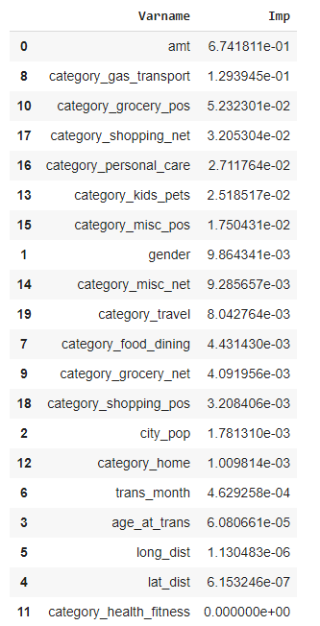
Key Insights
 Transaction amount, category and gender are the most important variables
 Gas and transport, grocery and shopping are the top three categories

Slide 6
Current Incurred Losses
 77,183 credit card transactions per month
 402 fraudulent transactions per month
 $ 530.66 amount per fraud transaction
 Total costs incurred from fraud transactions is $ 213,392.22

Slide 7
After New Model Deployment
 1720 fraudulent transactions detected by the model
 $ 1.5 cost to provide customer support to
these transactions that is $ 2,580.38 in total
 68 fraudulent transactions not detected by model which amounts to $ 35,908.09 loss
 Total cost incurred after new model deployment is $ 38,488.46
 Final savings after new model deployment is
$174,903.76 that is reduction in losses by ~82%

Slide 8
Appendix: Data Attributes
 Snapshot of the data:
index - Unique Identifier for each row
transdatetrans_time - Transaction DateTime
cc_num - Credit Card Number of Customer
merchant - Merchant Name
category - Category of Merchant
amt - Amount of Transaction
first - First Name of Credit Card Holder
last - Last Name of Credit Card Holder
gender - Gender of Credit Card Holder
street - Street Address of Credit Card Holder
city - City of Credit Card Holder
state - State of Credit Card Holder
zip - Zip of Credit Card Holder
lat - Latitude Location of Credit Card Holder
long - Longitude Location of Credit Card Holder
city_pop - Credit Card Holder's City Population
job - Job of Credit Card Holder
dob - Date of Birth of Credit Card Holder
trans_num - Transaction Number
unix_time - UNIX Time of transaction
merch_lat - Latitude Location of Merchant
merch_long - Longitude Location of Merchant
is_fraud - Fraud Flag <--- Target Class

Slide 9
Appendix: Data Methodology
 A random forest classifier built on top a Kaggle simulated dataset
 Class imbalance adjusted using Adaptive Synthetic (ADASYN) sampling method
 Manual hyperparameter tuning done due to extensive computational times when using Grid Search Cross Validation

Slide 10
Thanks !!

